Slide 1
Congruent or similar or neither
Geometrical properties and Pythagoras’ theorem

Slide 2
how to use Oak lessons

Slide 3
I can determine whether shapes are similar, congruent or neither.

Slide 4
Two shapes are similar if the only difference between them is their size. Their side lengths are in the same proportions.
If one shape can fit exactly on top of another using rotation, reflection or translation, then the shapes are congruent.

Slide 5

Congruent or similar or neither
Distinguishing between similarity and congruence
Checking for similarity and congruence

Slide 6
Distinguishing between similarity and congruence
When two shapes are congruent, the angles are the same in each shape and the lengths are the same in each shape.
When two shapes are similar, the angles are the same in each shape and the lengths are in the same proportions.
Shape A
congruent to Shape A
similar to Shape A
4 cm
37°
5 cm
37°
53°
4 cm
10 cm
3 cm
6 cm
53°
53°
5 cm
37°
3 cm
8 cm

Slide 7
Distinguishing between similarity and congruence
If two shapes are congruent then they are also similar.
If two shapes are similar then they are not necessarily congruent.
Similar shapes are only congruent if the scale factor between them is 1.
Shape A
congruent to Shape A
similar to Shape A
also similar to Shape A
incongruent to Shape A
× 1
4 cm
37°
5 cm
× 1
37°
53°
4 cm
10 cm
3 cm
6 cm
53°
53°
5 cm
37°
3 cm
× 1
8 cm

Slide 8
Distinguishing between similarity and congruence
All pairs of congruent shapes are also similar but only some pairs of similar shapes are also congruent.
Stating that shapes are congruent also implies that they are similar. Therefore, it is sufficient to state that shapes are congruent without stating that they are also similar.
A pair of shapes can also be neither congruent nor similar.
similar
neither congruent nor similar
congruent

Slide 9
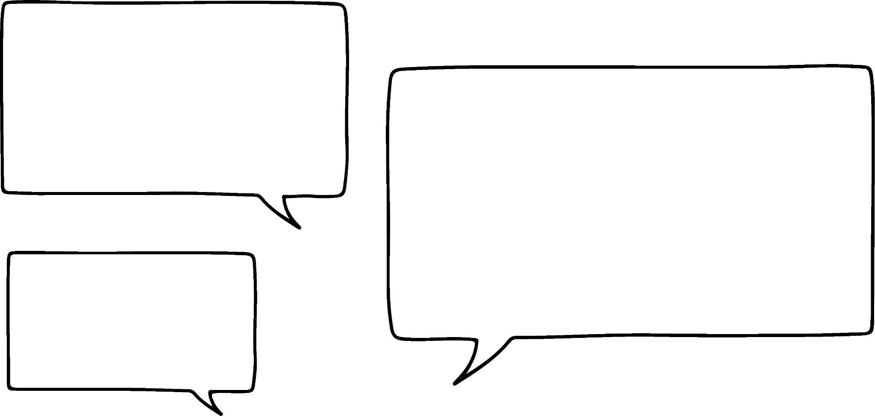

Distinguishing between similarity and congruence
Are these shapes congruent, similar or neither?
It doesn’t matter that the orientations are different.
They are both parallelograms with the same lengths and angles. So they are congruent.
75°
105°
75°
105°
8 cm
75°
105°
105°
10 cm
10 cm
75°
8 cm
Jun

Slide 10

Distinguishing between similarity and congruence
Are these shapes congruent, similar or neither?
They are not congruent because the lengths are different. One shape is an enlargement of the other, so they are similar.
105°
75°
75°
8 cm
105°
4 cm
105°
75°
105°
75°
5 cm
10 cm
Laura

Slide 11

Distinguishing between similarity and congruence
Are these shapes congruent, similar or neither?
60°
105°
75°
8 cm
120°
The angles are different, so they are neither congruent nor similar.
120°
10 cm
75°
105°
10 cm
60°
8 cm
Lucas

Slide 12



Distinguishing between similarity and congruence
Are these shapes congruent, similar or neither?
The angles are the same but the lengths are different. Does that mean they are similar?
105°
75°
105°
75°
8 cm
8 cm
75°
105°
75°
105°
10 cm
8 cm
Sofia
The lengths are not in the same proportion, so they are not similar. They are neither congruent nor similar.
Aisha

Slide 13

Distinguishing between similarity and congruence
The two shapes are .
Fill in the blank.
4 cm
100°
100°
5 cm
5 cm
congruent
80°
80°
6 cm
similar
5 cm
80°
6 cm
100°
neither congruent nor similar
4 cm
80°
100°
5 cm

Slide 14
Distinguishing between similarity and congruence
The two shapes are .
Fill in the blank.
4 cm
100°
100°
5 cm
5 cm
congruent
80°
80°
6 cm
similar
6 cm
100°
100°
5 cm
5 cm
neither congruent nor similar
80°
80°
8 cm

Slide 15
Distinguishing between similarity and congruence
The two shapes are .
Fill in the blank.
4 cm
100°
100°
5 cm
5 cm
congruent
80°
80°
6 cm
similar
3 cm
80°
80°
neither congruent nor similar
2.5 cm
2.5 cm
100°
100°
2 cm

Slide 16
Distinguishing between similarity and congruence
1) Compare each shape with Shape A and write the letters B to F in the Venn diagram.
2 cm
C
congruent to A
similar to A
3 cm
6 cm
A
5 cm
B
4 cm
D
4 cm
3 cm
6 cm
6 cm
E
neither congruent nor similar to A
6 cm
F
4 cm
9 cm

Slide 17

Distinguishing between similarity and congruence
2) The information describes five connected rectangles, with vertices at points A to L.
LC is a horizontal line with
length 2 units.
Point F is below Point C and CF = 2LC.
LCFI is a rectangle.
KLIJ is congruent to LCFI.
ABCL is congruent to LCFI.
CDEF is similar to LCFI but
not congruent.
FGHI is similar to LCFI but
not congruent.
Use the information to plot points A to L on the grid and draw the five rectangles.
L
C

Slide 18
Distinguishing between similarity and congruence
1) Compare each shape with Shape A and write the letters B to F in the Venn diagram.
2 cm
C
congruent to A
similar to A
3 cm
6 cm
A
5 cm
B
B
4 cm
C
D
E
D
4 cm
3 cm
F
6 cm
6 cm
E
neither congruent nor similar to A
6 cm
F
4 cm
9 cm

Slide 19
Distinguishing between similarity and congruence
2) The information describes five connected rectangles, with vertices at points A to L.
LC is a horizontal line with length 2 units.
Point F is below Point C and CF = 2LC.
LCFI is a rectangle.
KLIJ is congruent to LCFI.
ABCL is congruent to LCFI.
CDEF is similar to LCFI but not congruent.
FGHI is similar to LCFI but not congruent.
Use the information to plot points A to L on the grid and draw the five rectangles.
A
B
K
L
C
D
I
F
J
E
H
G

Slide 20
Distinguishing between similarity and congruence
2) The information describes five connected rectangles, with vertices at points A to L.
LC is a horizontal line with length 2 units.
Point F is below Point C and CF = 2LC.
LCFI is a rectangle.
KLIJ is congruent to LCFI.
ABCL is congruent to LCFI.
CDEF is similar to LCFI but not congruent.
FGHI is similar to LCFI but not congruent.
Use the information to plot points A to L on the grid and draw the five rectangles.
A
B
K
L
C
D
H
G
I
F
Other solutions are possible if the rectangles overlap, DE are fixed due to space on the grid.
J
E
H
G

Slide 21
Congruent or similar or neither
Distinguishing between similarity and congruence
Checking for similarity and congruence

Slide 22

Checking for similarity and congruence
congruence
similarity
If two shapes are congruent then…
If two shapes are similar then…
the angles are the same
the angles are the same
the angles are in the same order
the angles are in the same order
the lengths are the same
the lengths are in the same proportions
If two shapes have different angles then we can rule out both congruence and similarity.
Sam

Slide 23
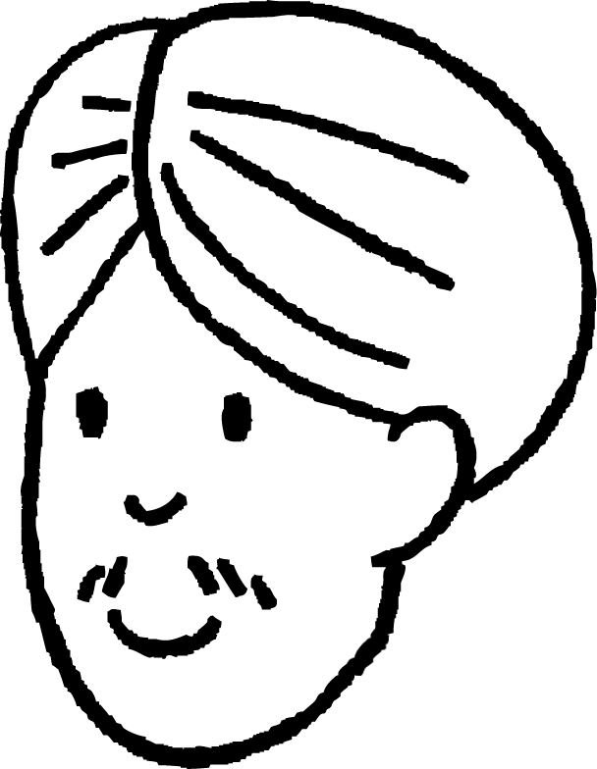
Checking for similarity and congruence
A table can be used to check that two shapes have the same angles in the same order.
100°
100°
100°
80°
Here is a 100° and 80° angle. So these could go here in the table.
A
B
80°
80°
80°
100°
shape A angles
shape B angles
100°
100°
80°
80°
100°
80°
Andeep

Slide 24
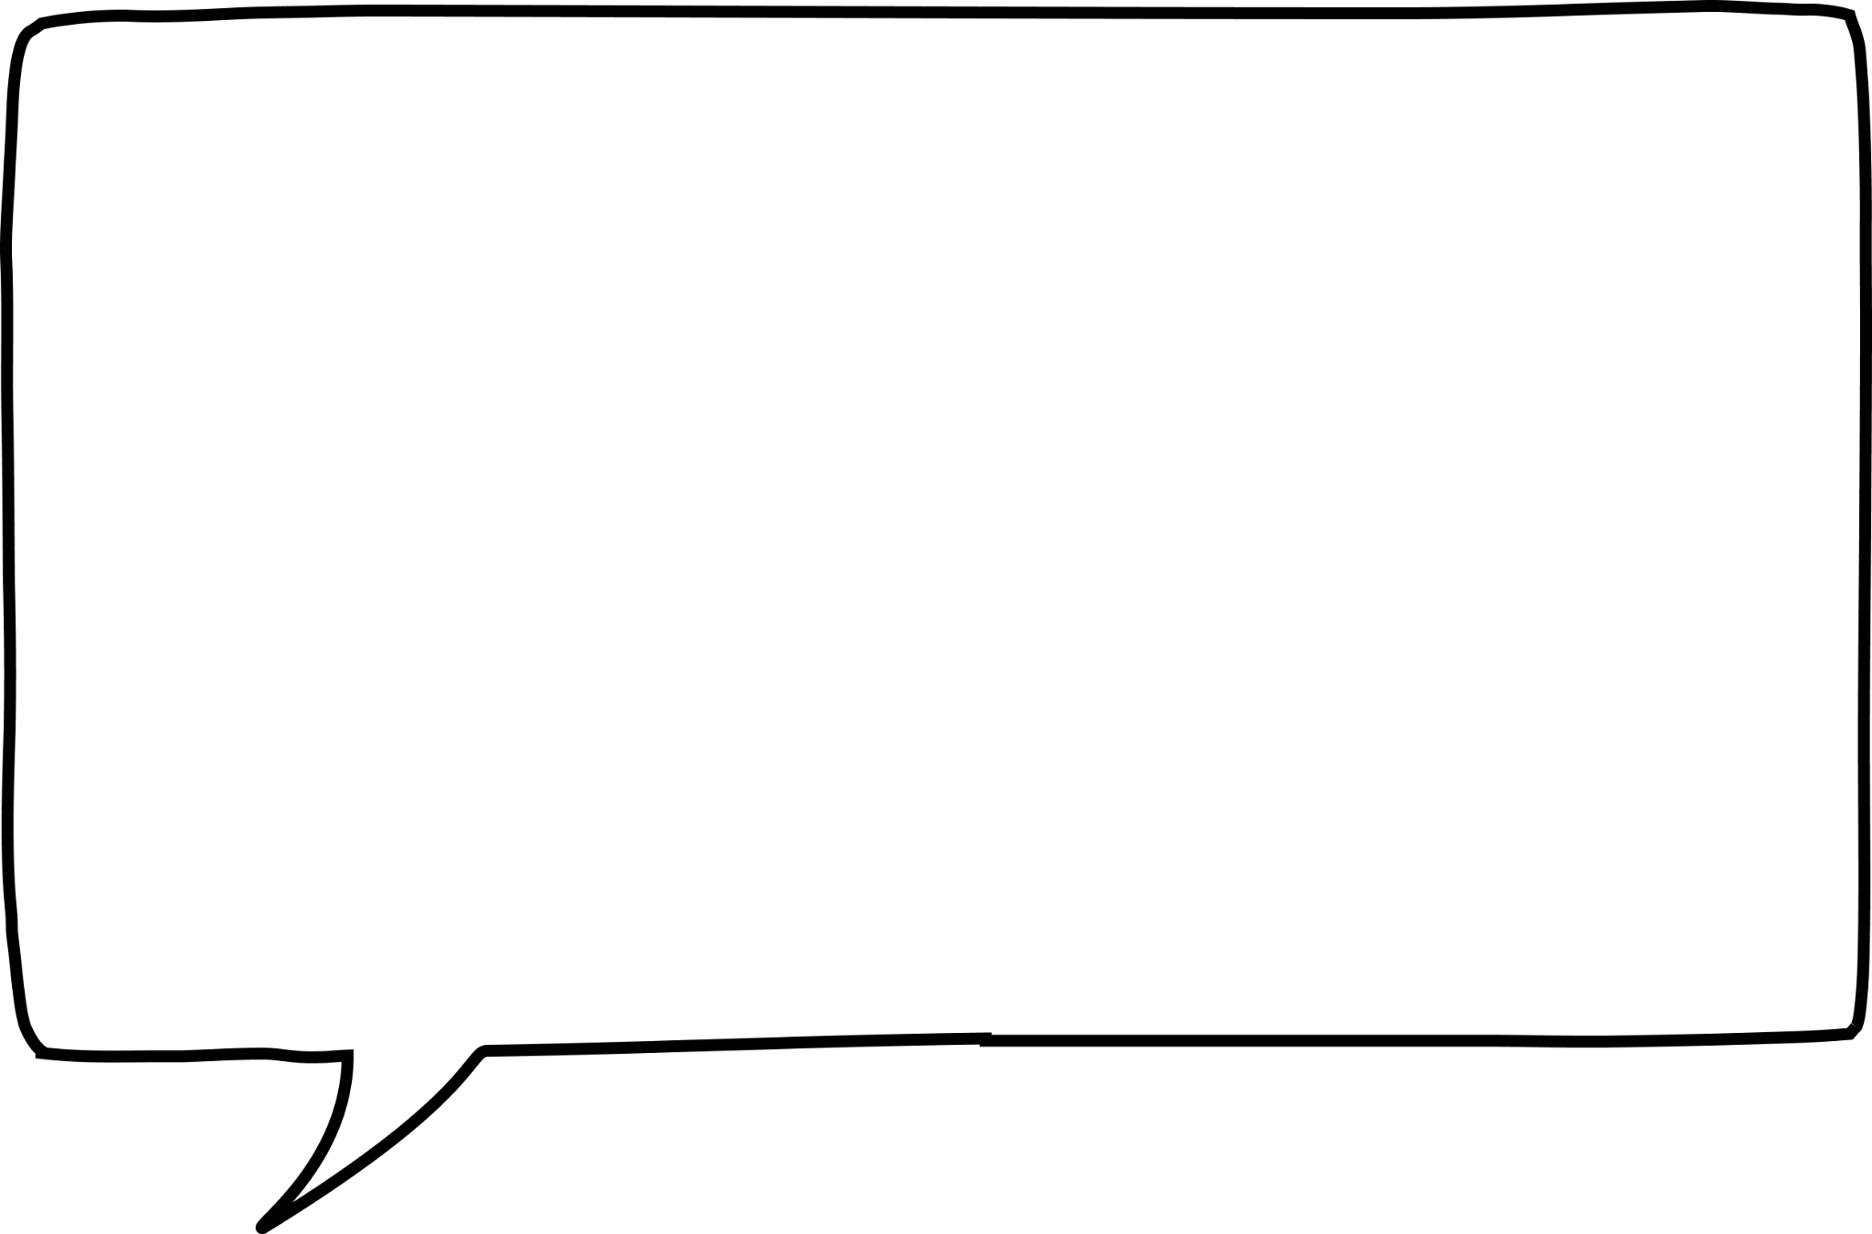
Checking for similarity and congruence
A table can be used to check that two shapes have the same angles in the same order.
But then the other angles don’t match.
100°
100°
100°
80°
Shape A has consecutive angles which are the same but shape B doesn’t.
A
B
80°
80°
80°
100°
shape A angles
shape B angles
100°
100°
80°
80°
80°
100°
80°
100°
The angles are the same but they are not in the same order. So the shapes are neither congruent nor similar.
Andeep

Slide 25
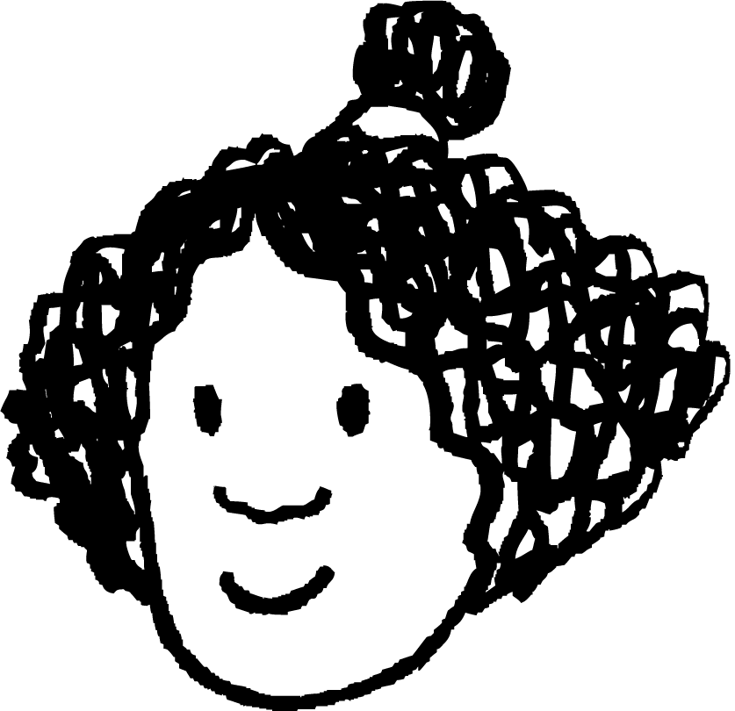
Checking for similarity and congruence
A table can be used to check that two shapes have the same angles in the same order.
Here are two consecutive 100° angles.
100°
100°
80°
80°
B
I can put these in the table first and then fill in the rest.
A
80°
80°
100°
100°
shape A angles
shape B angles
100°
100°
80°
80°
100°
100°
Izzy

Slide 26
Checking for similarity and congruence
A table can be used to check that two shapes have the same angles in the same order.
100°
100°
80°
80°
B
I can fill in the table in such a way that all the angles match up.
A
80°
80°
100°
100°
shape A angles
shape B angles
100°
100°
80°
80°
100°
100°
80°
80°
The shapes have the same angles in the same order, so they could be either congruent or similar.
Izzy

Slide 27
Checking for similarity and congruence
A table can be used to check that two shapes have the same angles in the same order.
100°
100°
80°
80°
I’ll need to know some lengths before I can determine if they are congruent or similar.
B
A
80°
80°
100°
100°
shape A angles
shape B angles
100°
100°
80°
80°
100°
100°
80°
80°
The shapes have the same angles in the same order, so they could be either congruent or similar.
Izzy

Slide 28
Checking for similarity and congruence
A table can be used to check multiplicatives relationships between lengths.
6 m
10 m
100°
100°
80°
80°
The edge between the two 100° angles is 6m.
8 m
8 m
B
A
8 m
8 m
I can fill in the rest of the table in the same way.
80°
80°
100°
100°
10 m
6 m
angles
100°
100°
80°
80°
shape A lengths (m)
shape B lengths (m)
10
6
8
8
Izzy

Slide 29
Checking for similarity and congruence
A table can be used to check multiplicatives relationships between lengths.
6 m
10 m
100°
100°
80°
80°
The edge between these two 100° angles is also 6m.
8 m
8 m
B
A
8 m
8 m
I can fill in the rest of the table in the same way.
80°
80°
100°
100°
10 m
6 m
angles
100°
100°
80°
80°
shape A lengths (m)
shape B lengths (m)
10
6
8
8
Izzy
6
8
10
8

Slide 30
Checking for similarity and congruence
A table can be used to check multiplicatives relationships between lengths.
6 m
10 m
100°
100°
80°
80°
8 m
8 m
B
The lengths are the same in the two shapes.
A
8 m
8 m
80°
80°
100°
100°
So they are congruent.
10 m
6 m
angles
100°
100°
80°
80°
shape A lengths (m)
shape B lengths (m)
8
10
8
6
× 1
× 1
× 1
× 1
Izzy
6
8
10
8

Slide 31
Checking for similarity and congruence
A table can be used to check multiplicatives relationships between lengths.
10 m
In this case, all the lengths in shape B are double the corresponding lengths in shape A.
3 m
80°
80°
100°
100°
B
4 m
4 m
A
8 m
8 m
80°
80°
100°
100°
So they are similar.
5 m
6 m
angles
100°
100°
80°
80°
shape A lengths (m)
shape B lengths (m)
4
5
4
3
× 2
× 2
× 2
× 2
Izzy
6
8
10
8

Slide 32
Checking for similarity and congruence
What is the value of x?
8 m
61°
6 m
138°
angles | 138° | 61° | 87° | 74°
10 m
lengths (m)
10
x
8
9
6
74°
87°
x = 9
9 m

Slide 33
Checking for similarity and congruence
The shapes A and B are .
Fill in the blank.
angles | 138° | 61° | 87° | 74°
congruent
shape A lengths (m) | 8 | 10 | 9 | 6
shape B lengths (m) | 24 | 30 | 27 | 18
similar
neither congruent nor similar

Slide 34
Checking for similarity and congruence
The shapes A and B are .
Fill in the blank.
angles | 138° | 61° | 87° | 74°
congruent
shape A lengths (m) | 8 | 10 | 9 | 6
shape B lengths (m) | 8 | 10 | 9 | 6
similar
neither congruent nor similar

Slide 35
Checking for similarity and congruence
1) a ) Fill in the table for shapes B and C, matching up the angles if you can.
72°
shape A angles | 116° | 127° | 72° | 135° | 90°
shape B angles
shape C angles
135°
B
127°
116°
b) Which shape is neither similar nor congruent to Shape A?
116°
135°
c) Is it possible to determine congruence for the other shape? Explain your answer.
C
72°
127°

Slide 36
Checking for similarity and congruence
2) a ) Fill in the table for shape B.
4 m
angles | 42° | 109° | 119° | 90°
119°
8 m
shape A lengths (m) | 6 | 4 | 2 | 8
shape B lengths (m)
16 m
B
109°
b) Are shapes A and B congruent, similar or neither? Justify your answer.
12 m
42°

Slide 37
Checking for similarity and congruence
1) a ) Fill in the table for shapes B and C, matching up the angles if you can.
72°
shape A angles | 116° | 127° | 72° | 135° | 90°
shape B angles
shape C angles
135°
116°
127°
72°
135°
90°
B
127°
90°
127°
72°
135°
116°
116°
b) Which shape is neither similar nor congruent to Shape A?
shape C
116°
135°
c) Is it possible to determine congruence for the other shape? Explain your answer.
C
No. Congruence cannot be determined without establishing whether the lengths are the same.
72°
127°

Slide 38
Checking for similarity and congruence
2) a ) Fill in the table for shape B.
4 m
angles | 42° | 109° | 119° | 90°
119°
8 m
shape A lengths (m) | 6 | 4 | 2 | 8
shape B lengths (m)
16 m
B
109°
12
8
4
16
b) Are shapes A and B congruent, similar or neither? Justify your answer.
12 m
42°
Shape B is similar to shape A. They have the same angles and the lengths in shape B are all double the lengths of shape A.
Shape B is an enlargement of shape A with a scale factor of 2.

Slide 39
Congruent or similar or neither
If two shapes are congruent, then they are also similar.
If two shapes are similar, it does not necessarily mean they are congruent.
Congruent shapes have a scale factor of one.
A ratio table can be a helpful tool for checking the multipliers.
The multiplicative relationship between sides of the object is preserved in its image with similar and congruent shapes.

Slide 40

© Oak National Academy 2024.
Produced in partnership with Mathematics in Education and Industry.
Licensed on the Open Government Licence v3.0, except where otherwise stated. See Oak terms and conditions.

